Slide 1
Netflix stocks 2017 Analysis
By: Matthew Salzano

Slide 2
Implementation
For this project I thought to break it down into different parts:
Gather the data from the information I was given along with any outside sources.
Create a basic plot that shows the months in 2017 (on x axis) vs the stocks (on the y axis). (Explain what data I found with the charts I make)
Use Pandas to create the Data Frame for the stocks.
Analyze the datasets I create and think of questions I may want to answer. What month(s) was the stocks the highest or lowest. Think of any columns I’d want to add or aggregate any data, I think of that’ll be useful.
Finally use Seaborn to gather any further data and explain it here. (With some implements of visual queues)

Slide 3
List of Visualizations
For this Capstone project I created and analyzed 4 main plots.
A violin plot that showed the quarterly data of Netflix. (Distribution of the stock prices for the past year)
Earnings per share in cents that was a scatter plot.
A bar graph that viewed the Earnings vs. Revenue. (Percent increases in the last main four quarters of 2017)
Finally a comparison of the Netflix Stock Price vs. Dow Jones Industrial Average price in 2017.

Slide 4
Information gathered / analyzed
I gathered a few important ideas that helped me better understand this project.
The dates for the NFLX.csv and DJI.csv were spread monthly. The daily_by_quarter.csv was spread daily/weekly to see how if the stocks increased or decreased from the opening timeline.
I could recognize off the bat was the price differences between Netflix and Dow Jones. (A rough $15,000 difference) It seemed Dow Jones always seemed to be increasing their stocks and sometimes Netflix would drop across the course of the early-mid months.

Slide 5
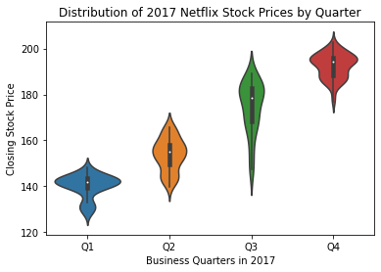
First Dataset
For the Business Quarterly violin_plot in the 3rd quarter was when most of the prices dropped immensely. (Highest Price ~ $205 , Lowest Price ~ $123)

Slide 6
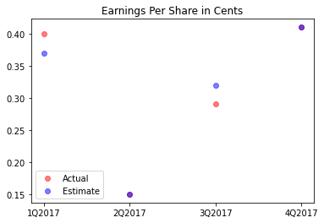
Second Dataset
For the earnings per share in Cents graph the red dots showed the actual cents and the blue symbolized the estimate earnings. The purple colors would indicate that specific quarters would have the same estimate and actual cent values.

Slide 7
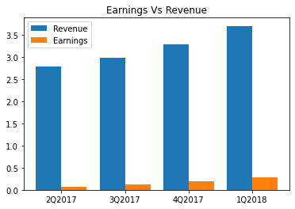
Third Dataset
Closely looking at a printed version of this graph I was able to roughly calculate the percent increases for the earnings and revenue throughout the 4 quarters.
Earnings is roughly a 1% increase from Q1-Q4.
Revenue is roughly a 2% increase from Q1-Q4.

Slide 8
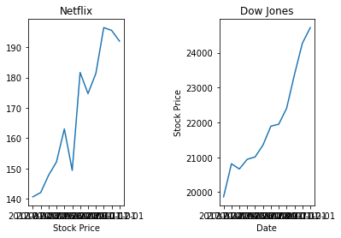
Fourth Dataset
During the course over time Netflix had some low peaks and from the two subplots it seemed Dow Jones did better in this case. It rarely had any drops except a tiny one early on in the week.
The prices are a huge difference between them. Practically a ~20000 difference. And Netflix was definitely the one stock who was most volatile.

